Slide 1
Co-Mining: A Processing-in-Memory Assisted Framework for Memory-Intensive PoW Acceleration

Slide 2
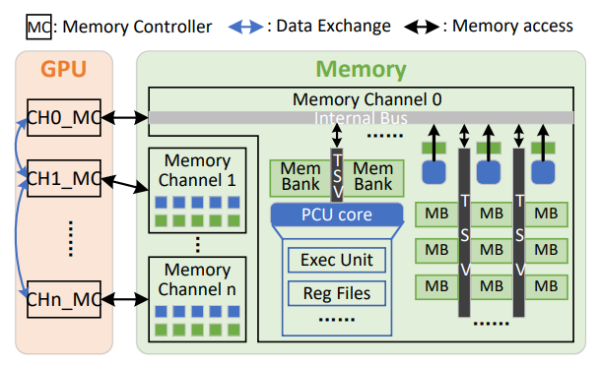
Research work—Background
Blockchain technologies have gained great attention and Proof-of-Work (PoW) algorithms are adopted to achieve consensus among all nodes to protect the distributed ledger from being tampered by malicious nodes.
Currently, PoW algorithms can be categorized into computation intensive and memory-intensive ones.
Bitcoin is computation intensive algorithm which focus on complicating the hash functions.
Ethash is memory intensive algorithm which integrate plenty of random memory accesses into their hash calculations.
HBM and PIM integrated technology opens a new door for memory-intensive PoW acceleration.

Slide 3
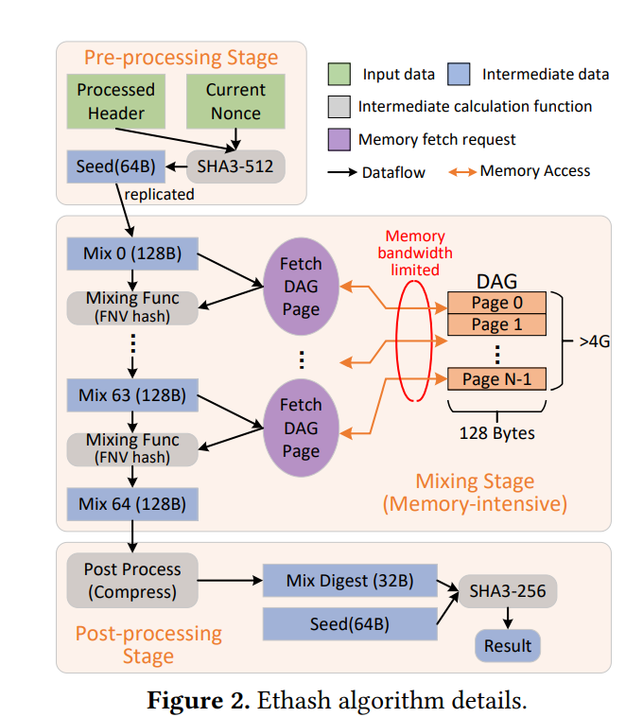
Research work—Background
Ethash algorithm.
Ethash try to find a nonce that generated a satisfied hash value output which is less than a predefined precision.
To test every nonce:
Firstly generate a seed using the SHA3-512.
Then begin memory fetching in each step of calculation in the mix phase.
FNV hash function is used for mixing the intermediate result with the newly
fetched memory data.
Each memory fetching address is determined by the previous mixing result.
The FNV hash produces pseudo-randomized and non-predictable address that have
no locality which is memory intensive.

Slide 4
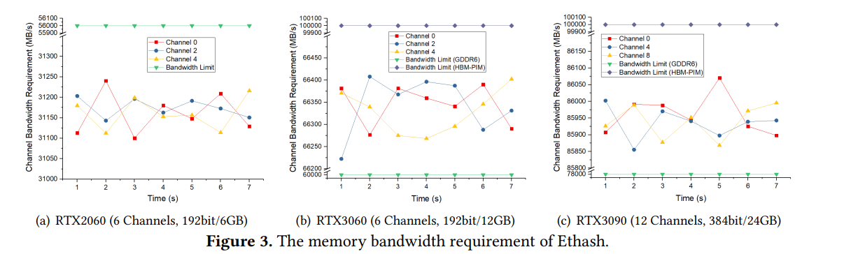
Research work—Problem
The widely-used GPU-only PoW solution, cannot fully exploit memory bandwidth due to memory channel conflict caused by huge amount of randomized memory accesses issued by the memory-intensive PoW algorithms.

Slide 5
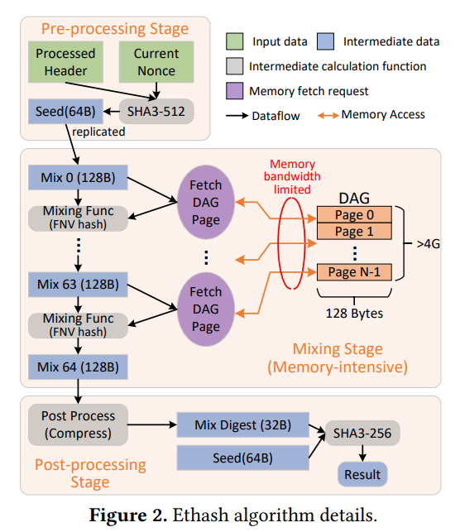
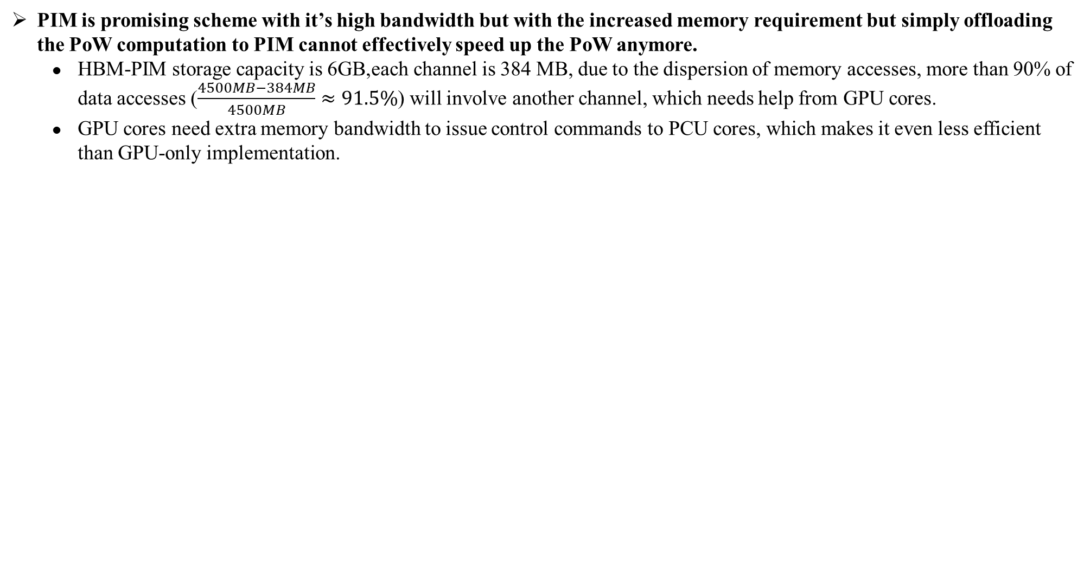
Research work—Problem
PIM is promising scheme with it’s high bandwidth but with the increased memory requirement but simply offloading the PoW computation to PIM cannot effectively speed up the PoW anymore.
HBM-PIM storage capacity is 6GB,each channel is 384 MB, due to the dispersion of memory accesses, more than 90% of data accesses ($\frac{4500MB−384MB}{4500MB}≈91.5\%$) will involve another channel, which needs help from GPU cores.
GPU cores need extra memory bandwidth to issue control commands to PCU cores, which makes it even less efficient than GPU-only implementation.

Slide 6
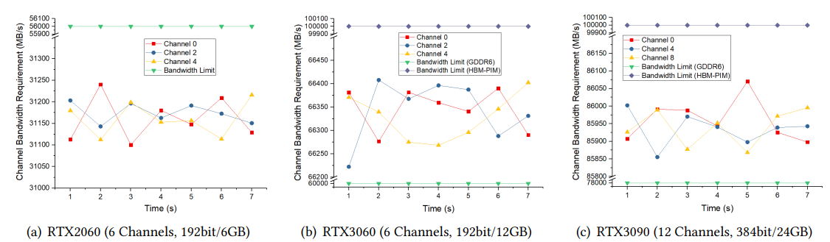
Research work—Motivation
Make PCU cores to explore the remaining memory bandwidth that can not be utilized by GPU cores.

Slide 7
Research work—Solution
Proposing a GPU/PIM Co-Mining framework to accelerate memory intensive PoW by fully exploiting HBM-PIM’s bandwidth and coordinately scheduling mining tasks in both GPU and PIM.
Separating the GPU threads into hash calculation thread and PIM control thread.

Slide 8
Research work—Challenge
How to coordinately schedule hash calculation threads and PIM control threads to fully exploit memory bandwidth during the mining process?
PIM core’ s number is limited so issue too many PIM control threads may consume too much memory bandwidth and block hash calculation threads.
PIM cores allow to switch between computation mode and memory mode but the GPU is unaware of PIM task status because PIM cores cannot actively notify GPU whether their tasks have been accomplished so the improper switches between these two modes would decrease the PIM working efficiency.

Slide 9
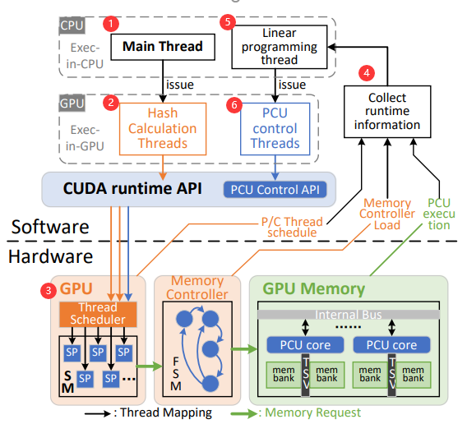
Research work—Technique
Co-mining Architecture.
Separating the GPU threads into hash calculation thread and PIM control thread.
The real-time requirement of GPU/PIM thread scheduling is not high, to reduce the performance impact of the scheduling task decision, we offload the linear programming solving to the CPU side and communicate with GPU through the PCIe bus.
Base on the collected bandwidth utilization of each memory channel and the current hashrate throughput to determine
whether should add more PCU control threads executing on GPU.

Slide 10
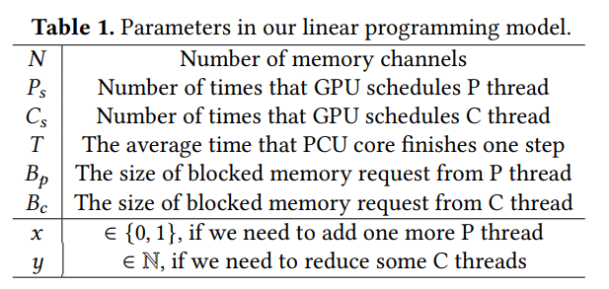
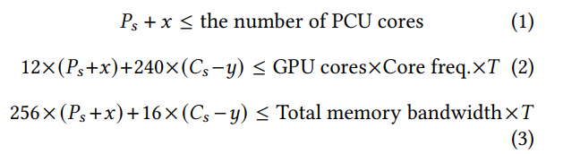
Research work—Technique
GPU/PIM task scheduling.
GPU uses 8 threads to compute 128-byte data in parallel and each C thread consumes about 240 cycles.
Defining the memory access density of each C thread as 16 Bytes/240 cycle.
P thread only has a branch to check if the PCU involves intra-channel or inter-channel memory requests and executes about 12 cycles then generates 256-byte memory access (read 128B intermediate result and write 128B to another PCU core).
Defining the memory access density of each P thread as 256 Bytes/12 cycle.
To determine whether the overall performance can benefit from adding more P threads so model it into a linear programming problem with the memory channel utilization as constraints.

Slide 11
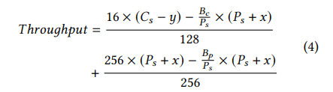
Research work—Technique
GPU/PIM task scheduling.
The throughput(how many steps are finished).
find the value of x on the CPU side to maximize the throughput (Equation 4) with the consideration of the constraints (1), (2) and (3)

Slide 12
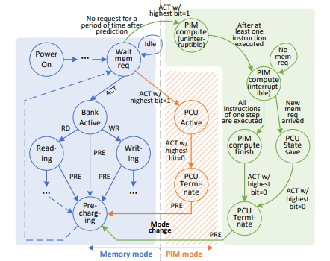
Research work—Technique
Fine-grained PIM core controller.
The traditional given memory controllers inside GPU are used to:
translate assembly LOAD/STORE code to memory operations (e.g., ACT, PRE, RD/WR).
issue PCU-related commands to handle the entry and exit of PIM mode.
Finite-state-machine model in the GPU memory controller to handle PCU core execution status to save unnecessary GPU requests.
Five stage:
(1) uninterruptable PIM compute state.
(2) interruptible PIM compute state.
(3) PIM compute finish state.
(4) PCU state save state.
(5) PCU terminate state.

Slide 13
Research work—Technique
Uninterruptable PIM compute state & interruptible PIM compute state.
When PCU is executing a instruction, if a new normal memory request arrives then can:
block this request until the PCU core finishes this instruction;
abort the PCU execution to serve this request immediately.
(1) Exiting compute mode immediately after entering it without doing anything.
(2) The PCU core frequency is far less than the GPU core (300MHz vs. 1680MHz) and one PCU core may take the time equivalent to more than 10 GPU clock cycles.

Slide 14
Research work—Technique
Uninterruptable PIM compute state & interruptible PIM compute state.
When PCU is executing a instruction, if a new normal memory request arrives then can:
block this request until the PCU core finishes this instruction.

Slide 15
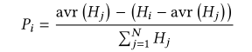
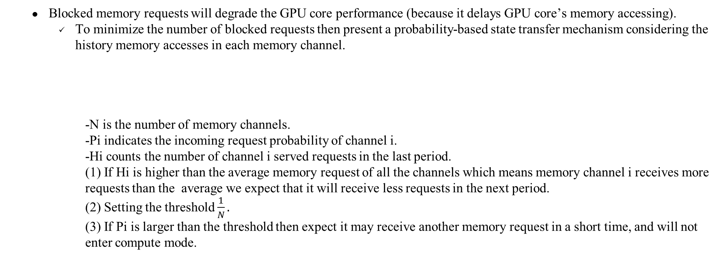
Research work—Technique
Uninterruptable PIM compute state & interruptible PIM compute state.
Blocked memory requests will degrade the GPU core performance (because it delays GPU core’s memory accessing).
To minimize the number of blocked requests then present a probability-based state transfer mechanism considering the history memory accesses in each memory channel.
-N is the number of memory channels.
-Pi indicates the incoming request probability of channel i.
-Hi counts the number of channel i served requests in the last period.
(1) If Hi is higher than the average memory request of all the channels which means memory channel i receives more requests than the average we expect that it will receive less requests in the next period.
(2) Setting the threshold $\frac{1}{N}.$
(3) If Pi is larger than the threshold then expect it may receive another memory request in a short time, and will not enter compute mode.

Slide 16
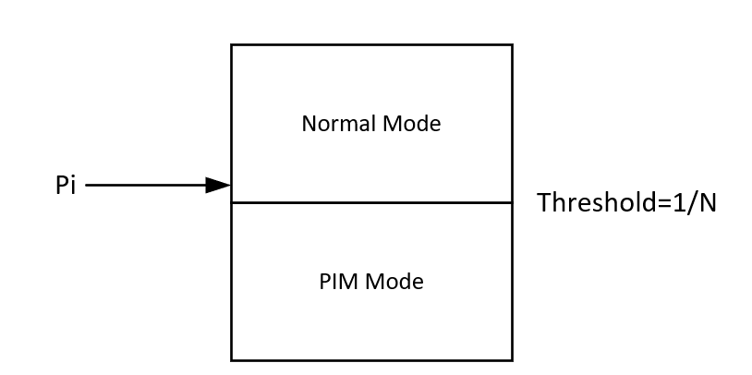
Research work—Technique
Uninterruptable PIM compute state & interruptible PIM compute state.
Blocked memory requests will degrade the GPU core performance (because it delays GPU core’s memory accessing).
To minimize the number of blocked requests then present a probability-based state transfer mechanism considering the history memory accesses in each memory channel.
- N is the number of memory channels.
- Pi indicates the incoming request probability of channel i.
- Hi counts the number of channel i served requests in the last period.
When determine not to enter compute mode but wait at least one PCU instruction execution time, which means the threshold is set relatively low.
- Increase the threshold by 1% .
When determine enter compute mode with normal memory requests blocked.
- Decrease the threshold by 1%.

Slide 17
Research work—Technique
PIM compute finish state, PCU state save state and PCU terminate state.
GPU cores are unaware of PCU task status because the in-memory PCU cores cannot actively transfer data to the GPU side.
Maintain the number of executed instructions for each PCU core in the memory controller.
Cannot directly get how many instructions are executed so use clock cycles instead to measure the execution since RISC-based PCU cores have fixed execution cycles for each instruction.
Once all the instructions are completed, it will enter the PIM compute finish state and the memory controller will notify the PIM control threads, making it explicitly change PCU-related banks back to memory mode.

Slide 18
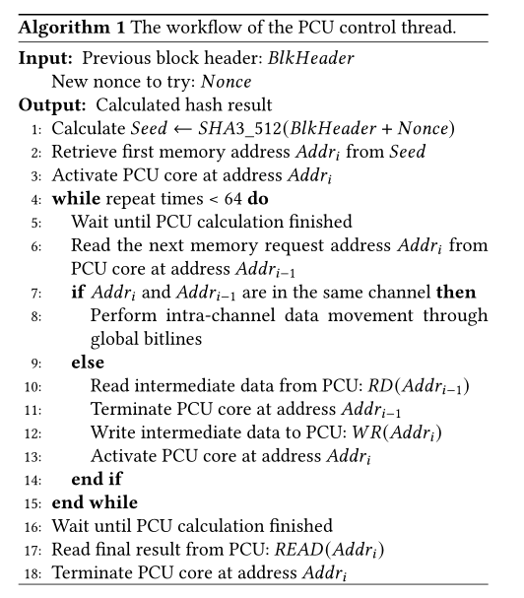
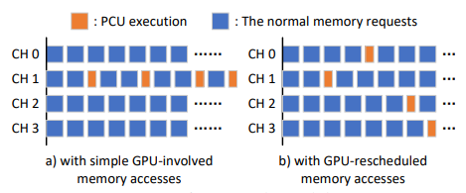
Research work—Technique
Intra-channel and Inter-channel memory access.
If make one PCU core calculate all the 64 steps of the mixing stage, the corresponding channel load will be significantly higher than the other channels.
make GPU cores read the 128-byte intermediate result from the current working PCU core and dispatch the calculation of the next step to another PCU core according to the next required memory address.
If the next required memory address locates in the same channel with the previous one, the PCU core can issue an intra-channel data transfer utilizing the global bitlines inside channel.

Slide 19
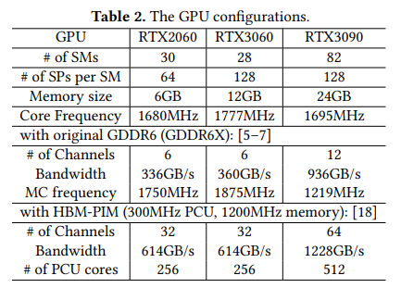
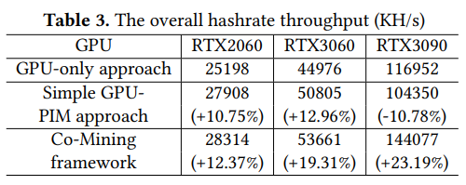
Research work—Evaluation
Experiment Setup.
Hashrate Throughput.
Co-mining framework achieves up to 38.5% hashrate improvement (144MH/s vs. 104MH/s) on RTX3090.

Slide 20
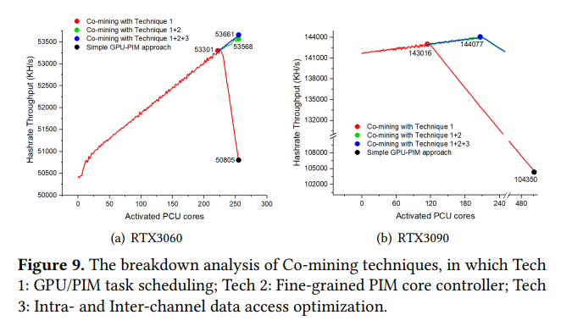
Research work—Evaluation
Hashrate Throughput.
Breakdown Analysis.

Slide 21
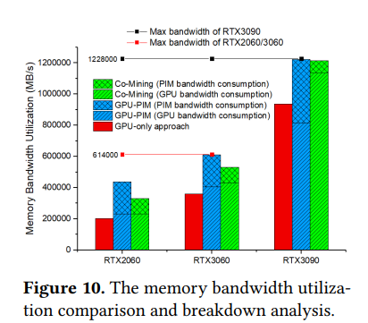
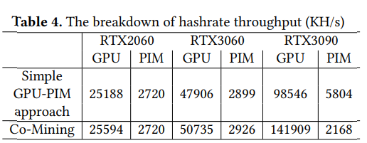
Research work—Evaluation
Memory Bandwidth Utilization.
Breakdown Analysis.

Slide 22
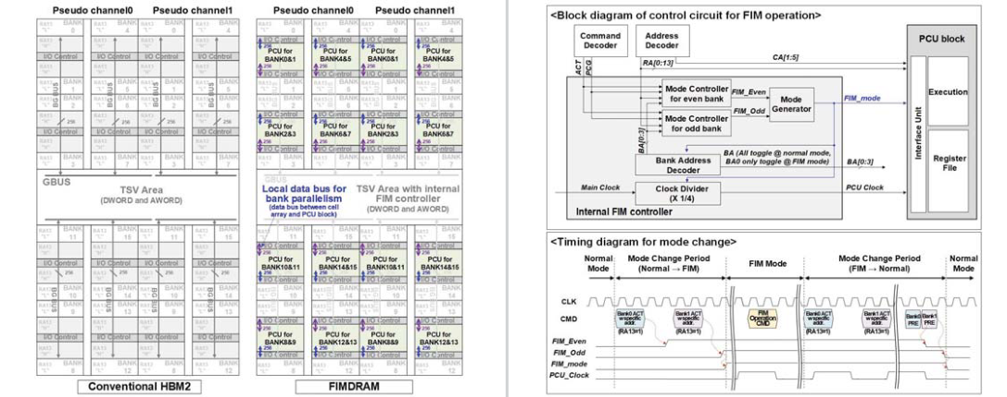
HBM-PIM的进一步理解
How to execute mode change between normal and PIM.
FIM mode entry can be initiated by a row activate (ACT) command with the 13th row-address bit high, and exit can be performed by ACT and precharge (PRE) commands.

Slide 23
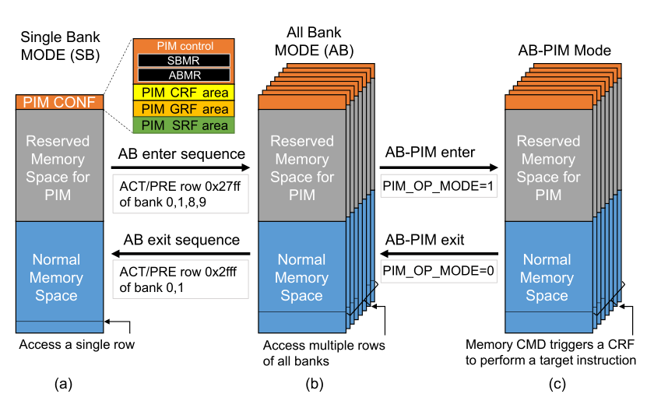
HBM-PIM的进一步理解
How to execute mode change between normal and PIM.
FIM mode entry can be initiated by a row activate (ACT) command with the 13th row-address bit high, and exit can be performed by ACT and precharge (PRE) commands.

Slide 24
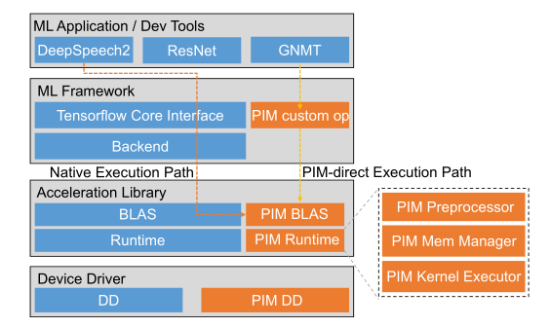
HBM-PIM的进一步理解
How to write initial instruction and operand to PCU.
PIM mode, configuration, general, command scalar registers are mapped to specific reserved memory addresses that can be accessed by standard DRAM commands.
The PIM memory manager governs the memory allocated by the PIM device driver, and stores not only generated PIM microkernel code (or CRF commands) but also the operand data in cache area for later use by traditional DRAM write instruction.
The PIM executor configures and invokes a PIM kernel.

Slide 25
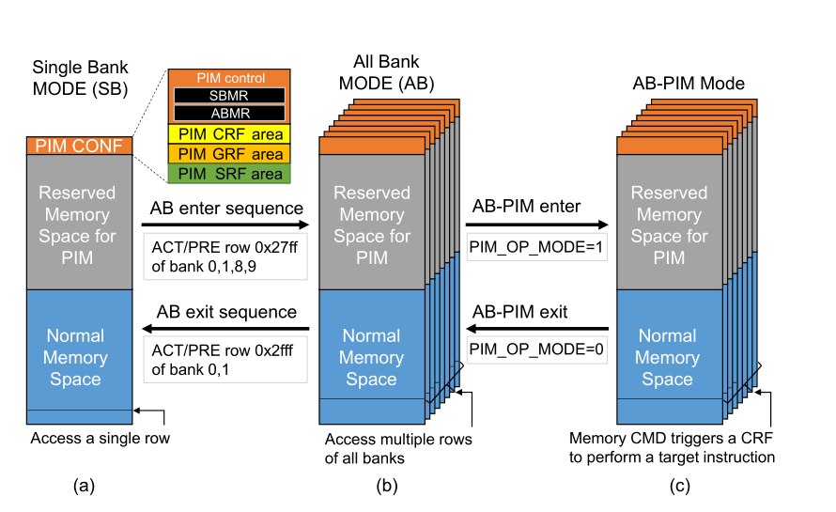
HBM-PIM的进一步理解
Why there is an All Band mode.
When in AB-PIM mode the instruction like read/write from host indicate the local address link to the PCU.
So the read/write command can’t send the host data(like CFR instructions) to PIM CONF region to every bank.
So enter the All Bank mode and write the CRF instruction to the PIM CONF to the PIM CONF of all bank in a pCH.

Slide 26
HBM-PIM的进一步理解
Reserved Memory for PIM & Normal Memory Space.
A bank can be configured to PIM mode and normal mode and no matter what mode banks are in the memory space is uncached to ensure the command from host can cache the PIM core.

Slide 27
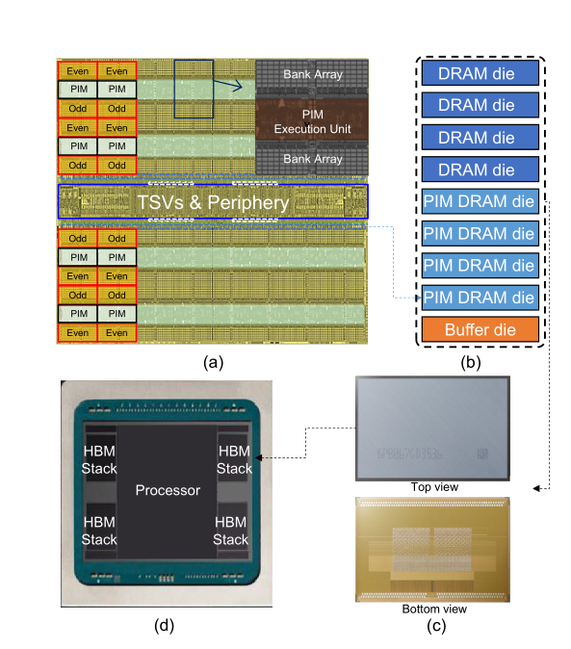
HBM-PIM
What can we do to further improve the performance of PIM-HBM system.
There are 2GB PIM memory die and 4GB normal memory die.
The 2GB PIM die are uncached whether it is in PIM memory space and Normal memory space and the characteristic of uncached degrade the GPU performance, so can we transports the data from PIM die to normal die then the data can be cached.
Data locality.
Data movement between PIM die and normal die.
Data dependency.

